Slide 1
Finite State Machine (FSM)
If a system has $K$ many registers for storing its state, how many different states can it be in?
An FSM is a circuit/system/”machine” that can exist in many different states.
It has M inputs, N outputs, and K bits of state.
It also receives a clock and, optionally, a reset signal.
An FSM consists of two blocks of combinational logic, next state logic and output logic, and a register(s) that stores the state.
$$2^{K}$$
$$2^{K}$$

Slide 2
Finite State Machine (FSM)
Consists of:
State register(s)
Stores current state
Loads next state at clock edge
Combinational logic
Computes the next state
Computes the outputs

Slide 3
Finite State Machines (FSMs)
State register stores the current state
Next state determined by current state and inputs
Two types of finite state machines differ in output logic:
Moore FSM: outputs depend only on current state
Mealy FSM: outputs depend on current state and inputs

Slide 4
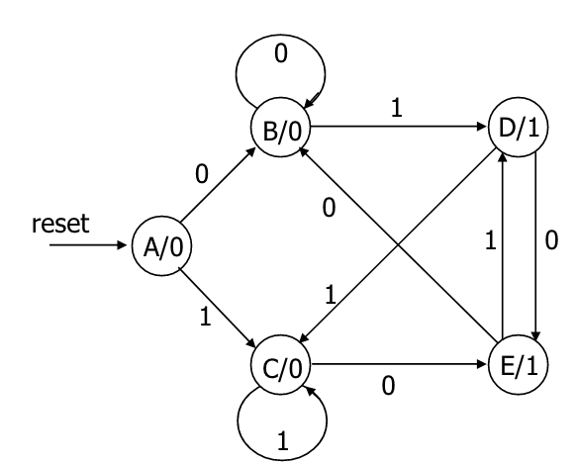
Moore Machines
Design example: edge detector: output a one every time the input flips and a zero otherwise

Slide 5
Finite State Machines (FSMs)
State register stores the current state
Next state determined by current state and inputs
Two types of finite state machines differ in output logic:
Moore FSM: outputs depend only on current state
Mealy FSM: outputs depend on current state and inputs

Slide 6
Mealy Machines
Mealy machines react faster to inputs:
React in same cycle—don't need to wait for clock.
Mealy machines tend to have fewer states
Moore machines are safer to use:
Outputs change at clock edge (always one cycle later).
In Mealy machines, input change can cause output change as soon as logic is done—a big problem when two machines are interconnected – asynchronous feedback may occur if one isn't careful.
Mealy machines can have simpler designs (fewer states).

Slide 7
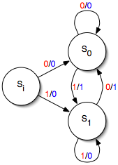
Mealy Machines
Design example: edge detector: output a one every time the input flips and a zero otherwise

Slide 8
Mealy Machines
Design example: edge detector: output a one every time the input flips and a zero otherwise

Slide 9
Mealy and Moore Comparison
Mealy FSM – Sequence Detector
Recognize: 1 1 0 1

Slide 10
Mealy and Moore Comparison
→
X 1 1 0 1
Z 0 0 0 1

Slide 11
Mealy and Moore Comparison
Reset
1 / 0
1 / 0
A
B
C
1 / 1
0 / 0
D
X 1 1 0 1
Z 0 0 0 1

Slide 12

Mealy and Moore Comparison
1 / 0
Reset
1 / 0
1 / 0
A
B
C
0 / 0
0 / 0
1 / 1
0 / 0
0 / 0
D
X 1 1 0 1
Z 0 0 0 1

Slide 13
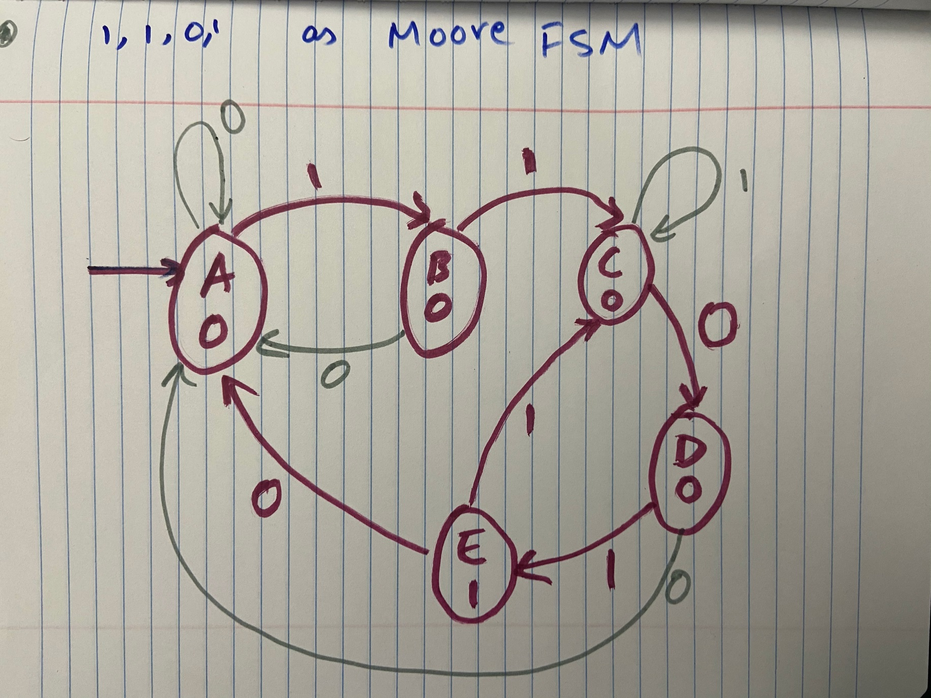
Moore FSM for 1101

Slide 14

Moore Machine Full Example
CLK
Bravado Blvd
Inputs
$T_{B}$: High/True/1 when there is traffic present on Bravado Blvd
${\overline{T}}_{B}$: High/True/1 when there is not traffic present on Bravado Blvd
$$T_{A}$$
$$L_{A}$$
Traffic Light Controller
$$T_{B}$$
$$L_{B}$$
Outputs:
$L_{B}$: {red, yellow, green}
RESET
Academic Ave.
Inputs
$T_{A}$: High/True/1 when there is traffic present on Academic Ave
${\overline{T}}_{A}$: High/True/1 when there is not traffic present on Academic Ave
Outputs:
$L_{A}$: {red, yellow, green}

Slide 15
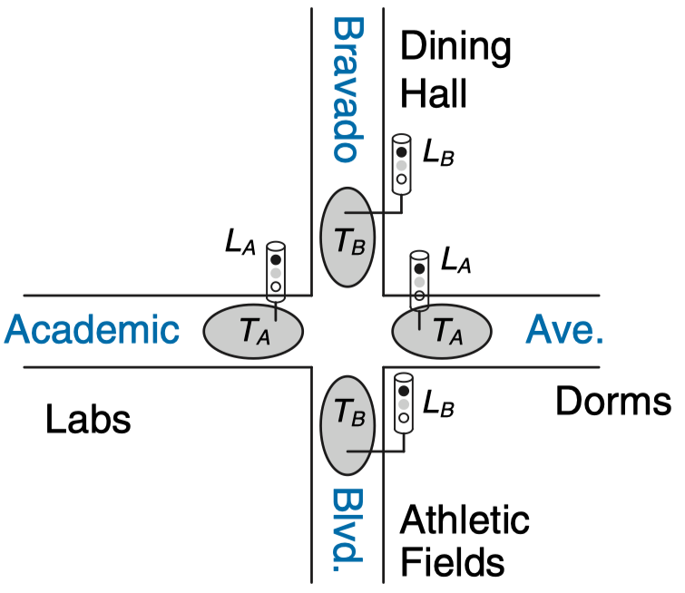
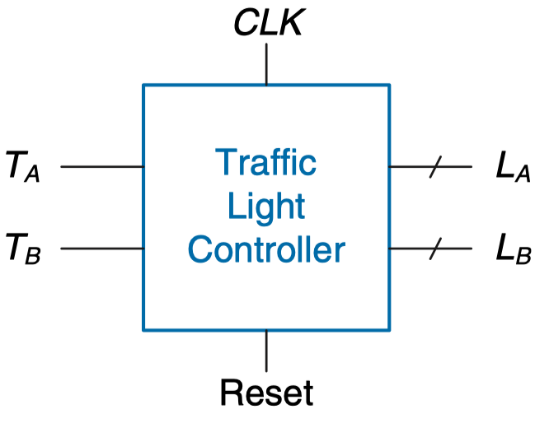
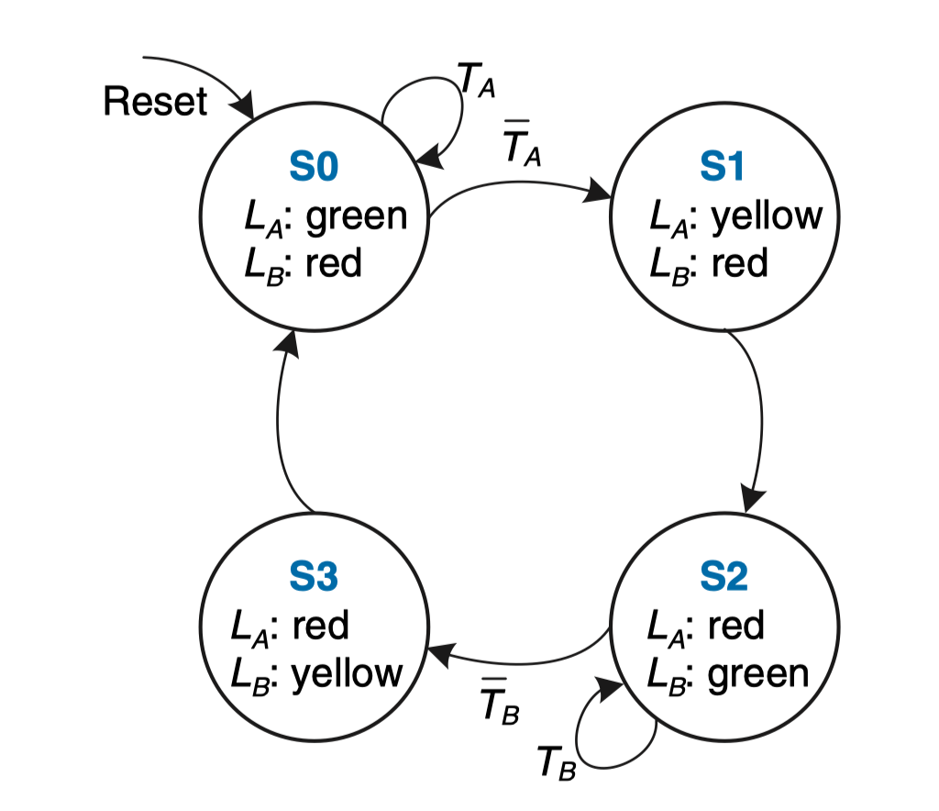
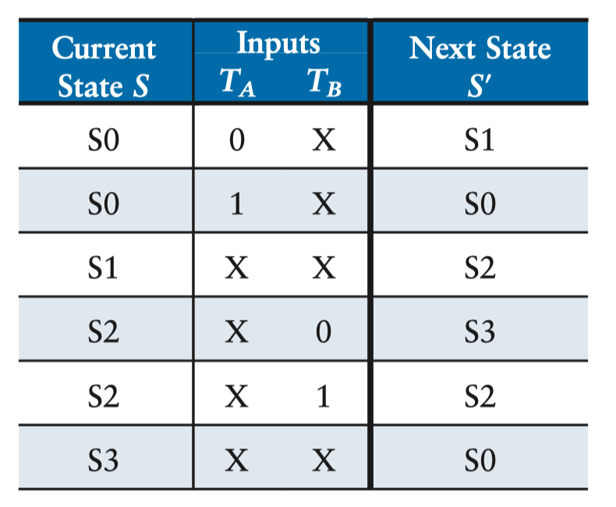
Moore Machine Full Example
$T_{A}$: High/True/1 when there is traffic present on Academic Ave
${\overline{T}}_{A}$: High/True/1 when there not traffic present on Academic Ave
$T_{B}$: High/True/1 when there is traffic present on Bravado Blvd
${\overline{T}}_{B}$: High/True/1 when there not traffic present on Bravado Blvd
State Transition Table

Slide 16
FSM Encoding
Binary encoding:
i.e., for four states, 00, 01, 10, 11
One-hot encoding
One state bit per state
Only one state bit HIGH at once
i.e., for 4 states, 0001, 0010, 0100, 1000
Requires more flip-flops
Often next state and output logic is simpler

Slide 17
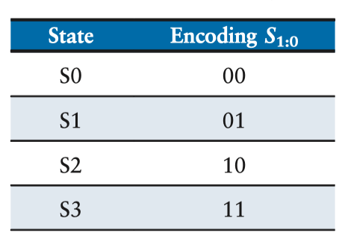
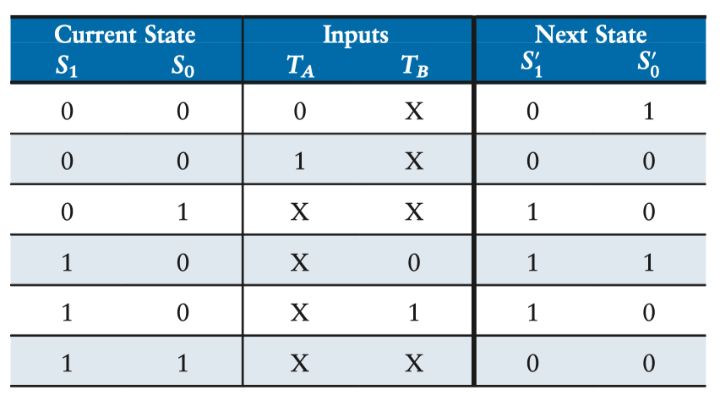
FSM States
State Transition Diagram
State Transition Table
State Encodings
Full State Transition Table

Slide 18
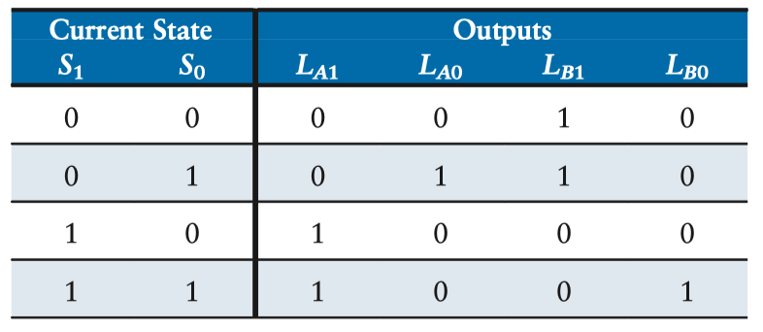
FSM Recap
State Transition Diagram
State Transition Table
Full Transition Table
Output Table

Slide 19
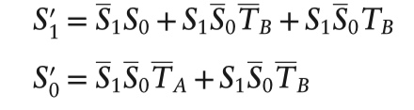
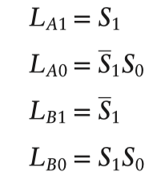
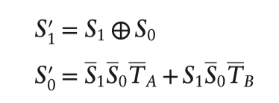
FSM Equations
Full Transition Table
Output Table

Slide 20
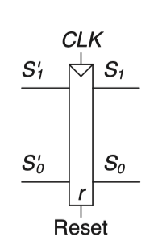

Last Week’s Task
Given the diagram shown below, identify equations for each output (LA1, LA0, LB1, LB0) as well as the intermediate values S1’ and S0’. Implement your findings in Hardcaml!
This is just the implementation of the FSM logic from the last slide!

Slide 21
Before Moving On
In order to properly use the display feature of our boards, we need to incorporate a small fix of Hardcaml
After opening your terminal and starting up your ubuntu instance (or whatever your usual process is to start working), run the following:
opam update --all
opam upgrade

Slide 22
This Week’s Tasks
I would encourage one of a few routes (after doing any preliminary exploration of pre-created programs, documentation reading, etc.)
Base the direction of the counter on whenever a specific binary sequence is recognized (see document on the repository for more details)
Look up a common application area for finite state machines (such as a washing machine, vending machine, etc.). Implement a modified version of that control scheme in Hardcaml
Start brainstorming a final project to primarily work on over the next few weeks. If you would like to experiment with any board attachments, please let me know ASAP!
https://digilent.com/shop/products/fpga-boards/expansion-modules/pmods/

Slide 23
Some helpful course pages
https://hardcaml-mini-course-at-stevens.github.io/hardcaml-docs/designing-circuits/sequential_logic
https://hardcaml-mini-course-at-stevens.github.io/hardcaml-docs/more-on-circuit-design/state_machine_always_api

